Slide 1
My Shape and Angles
Interactive Notebook
Name
Class
Term 3 Semester 2

Slide 2
Contents
Formula Page
Page
Date
Description
2
3

Slide 3
Tasks
24
7
30
Essential Question
Questions
Notes
Summary
4
5

Slide 4
Task 1
Match the cards
Word – Description – Picture

Slide 5
24
7
30
Date
Introduction to angles
What is the difference between complementary and supplementary angles?
5

Slide 6
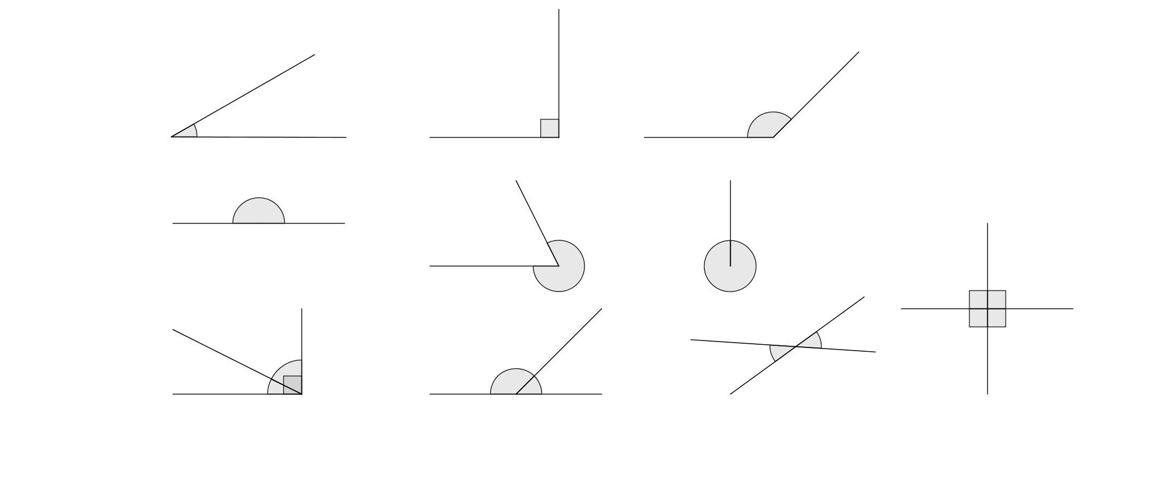

24
7
30
Date
Introduction to angles
What is the difference between complementary and supplementary angles?
Complementary angles add to 90$°$ (Right angle)
a
40$°$
5

Slide 7
24
7
30
Date
Introduction to angles
What is the difference between complementary and supplementary angles?
Complementary angles add to 90$°$ (Right angle)
a
40$°$
a = 90 – 40
5

Slide 8
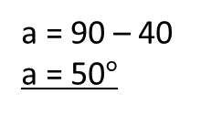

24
7
30
Date
Introduction to angles
What is the difference between complementary and supplementary angles?
Complementary angles add to 90$°$ (Right angle)
a
a = 90 – 40
a = 50$°$
40$°$
5

Slide 9

24
7
30
Date
Introduction to angles
What is the difference between complementary and supplementary angles?
Complementary angles add to 90$°$ (Right angle)
a
a = 90 – 40
a = 50$°$
40$°$
Supplementary angles add to 180$°$ (Straight Line)
130$°$
b
5

Slide 10
24
7
30
Date
Introduction to angles
What is the difference between complementary and supplementary angles?
Complementary angles add to 90$°$ (Right angle)
a
a = 90 – 40
a = 50$°$
40$°$
Supplementary angles add to 180$°$ (Straight Line)
b = 180 - 130
130$°$
b
5

Slide 11
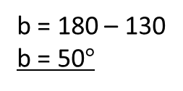
24
7
30
Date
Introduction to angles
What is the difference between complementary and supplementary angles?
Complementary angles add to 90$°$ (Right angle)
a
a = 90 – 40
a = 50$°$
40$°$
Supplementary angles add to 180$°$ (Straight Line)
b = 180 – 130
b = 50$°$
130$°$
b
5

Slide 12

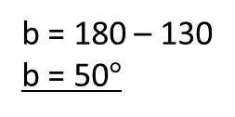

24
7
30
Date
Introduction to angles
What is the difference between complementary and supplementary angles?
Supplementary angles add to 180$°$ (Straight Line)
b = 180 – 130
b = 50$°$
130$°$
b
Vertically opposite angles are equal
c
45$°$
5

Slide 13
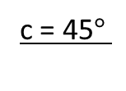
24
7
30
Date
Introduction to angles
What is the difference between complementary and supplementary angles?
Supplementary angles add to 180$°$ (Straight Line)
b = 180 – 130
b = 50$°$
130$°$
b
Vertically opposite angles are equal
c = 45$°$
c
45$°$
5

Slide 14
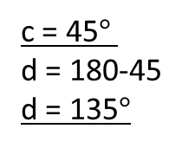
24
7
30
Date
Introduction to angles
What is the difference between complementary and supplementary angles?
Supplementary angles add to 180$°$ (Straight Line)
b = 180 – 130
b = 50$°$
130$°$
b
Vertically opposite angles are equal
c = 45$°$
d = 180-45
d = 135$°$
d
c
45$°$
5

Slide 15
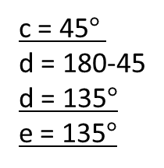
24
7
30
Date
Introduction to angles
What is the difference between complementary and supplementary angles?
Supplementary angles add to 180$°$ (Straight Line)
b = 180 – 130
b = 50$°$
130$°$
b
Vertically opposite angles are equal
c = 45$°$
d = 180-45
d = 135$°$
e = 135$°$
d
c
45$°$
e
5

Slide 16
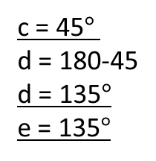


24
7
30
Date
Introduction to angles
What is the difference between complementary and supplementary angles?
Vertically opposite angles are equal
c = 45$°$
d = 180-45
d = 135$°$
e = 135$°$
d
c
45$°$
e
Angles in a revolution add to 360$°$
60$°$
f
5

Slide 17
24
7
30
Date
Introduction to angles
What is the difference between complementary and supplementary angles?
Vertically opposite angles are equal
c = 45$°$
d = 180-45
d = 135$°$
e = 135$°$
d
c
45$°$
e
Angles in a revolution add to 360$°$
f = 360 – 60
60$°$
f
5

Slide 18
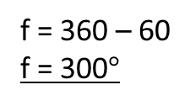
24
7
30
Date
Introduction to angles
What is the difference between complementary and supplementary angles?
Vertically opposite angles are equal
c = 45$°$
d = 180-45
d = 135$°$
e = 135$°$
d
c
45$°$
e
Angles in a revolution add to 360$°$
f = 360 – 60
f = 300$°$
60$°$
f
5

Slide 19
Fill in the questions

Slide 20
24
7
30
Date
Introduction to angles
What is the difference between complementary and supplementary angles?
How do you use the angle properties to find missing angles?
Complementary angles add to 90$°$ (Right angle)
a
a = 90 – 40
a = 50$°$
40$°$
Supplementary angles add to 180$°$ (Straight Line)
b = 180 – 130
b = 50$°$
130$°$
b
5

Slide 21
Notes Review
24, 7 ,30
Date
Title
Essential question
Notes complete
Notes complete with colour and diagrams
Questions completed
Contents page filed in
Formula page filled in

Slide 22
Homework
Review your notes and write a summary answering the essential question.

